Slide 1
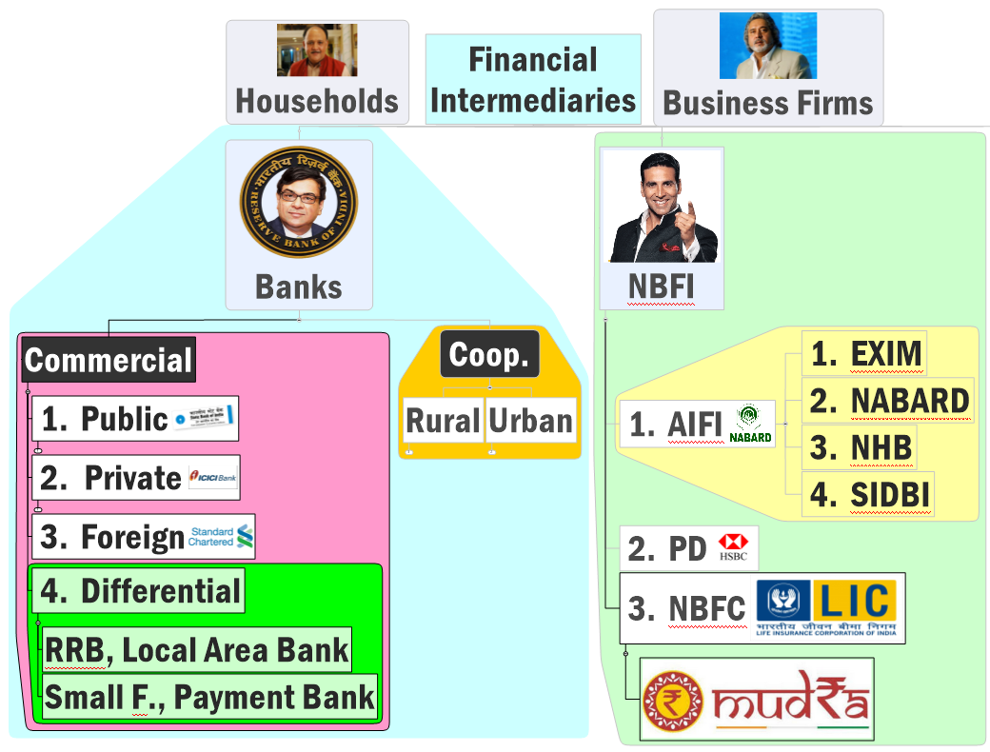



Origin
Structure
Functions
Nationalization
Merger

Slide 2
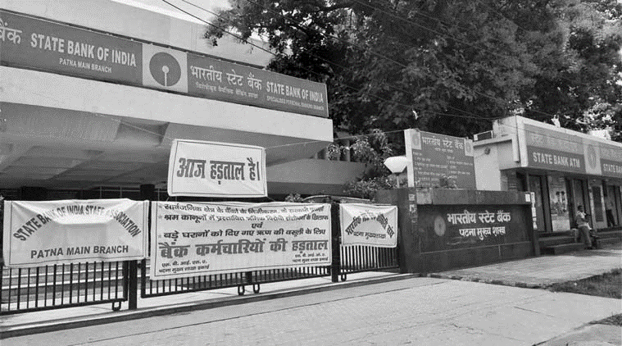
Problems of Nationalized / “Sarkari Banks / PSB
Administered interest rates: low profitability
Govt. shareholding-> politicized “Boards”, experts less, branch expansion??
Unviable greenfield projects on Political Considerations->High NPA, low recovery
RBI would keep high CRR, SLR to prevent failure
Aam-aadmi deprived of loans @reasonable rates
Large staff, unionized staff: customer service….x

Slide 3
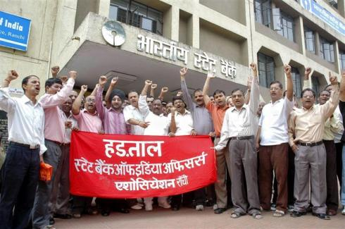
Nationalization of Private Banks created more problems than it solved
Politicized branch expansion, recruitment
Notes:
PVB can absorb some of the staff and provide competition

Slide 4
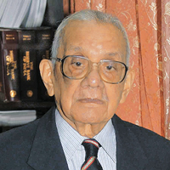
1991: M.Narsimhan Committee for Banking sector reforms
Branch expansion
Liberal policy
25% rural mandate
New private banks
’93
01
13
White-table ATM 1:2
Reduce Govt Ctrl
Shares selling
UTI/AXIS
IDBI<50% (‘16)
New foreign banks
“on tap”
‘reciprocal bases”.
Narsimhan is the first and only RBI ‘career’ officer so far, to become RBI Governor

Slide 5
License round #1: 1993-95
ICICI ‘55
IDBI’64 Act
Govt, World Bank & other FI;
DFI, regulatory body for industrial finance
UTI’63 Act
Sarkaari MF
DFI: industrial investment & underwriting
100% RBI subsidiary->GoI (‘76)
Private Banks License Round #1 (1993-95)
ICICI Bank ltd.
UTI Bank ltd.
Axis Bank ‘07
IDBI Bank ltd
<50% (‘16)*
Parent merge ‘02
Parent merge’04
Notes:
http://profit.ndtv.com/stock/axis-bank-ltd_axisbank/reports
Axis Bank established in 1993 was the first of the new private banks to have begun operations in 1994 after the Government of India allowed new private banks to be established.Axis Bank Ltd. has been promoted by the largest and the best Financial Institution of the country, UTI. The Bank was set up with a capital of Rs. 115 crore, with UTI contributing Rs. 100 crore, LIC – Rs. 7.5 crore and GIC and its four subsidiaries contributing Rs. 1.5 crore each.Axis Bank is one of the first new generation private sector banks to have begun operations in 1994. The Bank was promoted in 1993, jointly by Specified Undertaking of Unit Trust of India (SUUTI) (then known as Unit Trust of India),Life Insurance Corporation of India (LIC), General Insurance Corporation of India (GIC), National Insurance Company Ltd., The New India Assurance Company Ltd., The Oriental Insurance Company Ltd. and United India Insurance Company Ltd. The shareholding of Unit Trust of India was subsequently transferred to SUUTI, an entity established in 2003.
http://www.business-standard.com/article/specials/rbi-grants-bank-licence-to-idfc-bandhan-114040200963_1.html

Slide 6
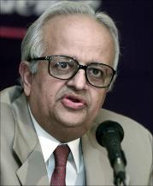
Bank licenses: Three Rounds of License
1993-95 (6+4=10)
ICICI
2001-04 (2)
Kotak Mahindra
Yes Bank
2013-16 (2)
Bandhan Microfin (W.Bengal )
IDFC (Mumbai power-infra- NBFC)
UTI=>Axis (2007)
IDBI (‘64 DFI)=> merger with parent=>Budget’16 <50%
Indus
DCB
HDFC
3rd round: Bimal Jalan Committee shortlisted them.
1000 cr. Networth [assets-liability]
25% branches in unbanked rural areas
Then license under Banking Regulation Act, 1949 [Sec.22(1)]
Global Trust Bank (2001 scam=>Merged in OBC)
Bank of Punjab=>Centurion bank
Centurian Bank=>(HDFC)
Times Bank (HDFC)
BMB was ‘outside’ rounds, got license directly.
Notes:
BMB doesn’t fit here.
6 Working
ICICI
HDFC
UTI=>Axis (2007)
IDBI (‘64 indirect fin.)
Indus
DCB
4 collapse
Global Trust Bank (2001 scam, OBC)
Bank of Punjab=>Centurion
Centurion =>(HDFC)
Times Bank=> (HDFC)

Slide 7
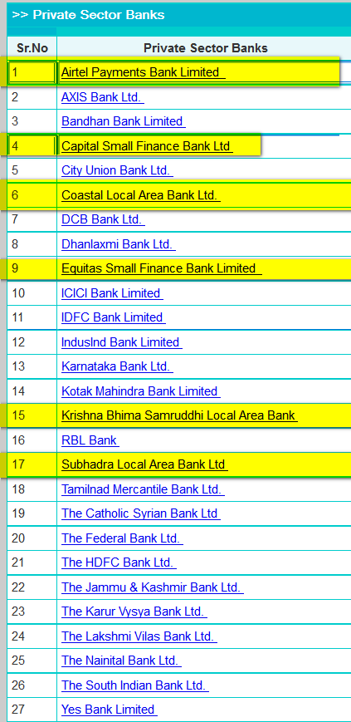

Universal Private commercial banks in India? (REF IBA)
Old Not nationalized. (12)
Catholic Syrian Bank Ltd
Dhanlaxmi Bank
RBL Bank
Tamilnad Mercantile Bank
City Union Bank
Federal Bank
Jammu & Kashmir Bank
Karur Vysya Bank
Lakshmi Vilas Bank
Nainital Bank
South Indian Bank
Karnataka Bank
Round1 (6-1 IDBI?=5)
HDFC Bank
DCB Bank
ICICI Bank
IndusInd Bank
AXIS Bank
Round2 (2)
Yes Bank
Kotak Mahindra Bank
Round3 (2)
Bandhan
IDFC
21 right now
If IDBI <50%= 22
Notes:
Wrong given in Wikipedia https://en.wikipedia.org/wiki/Private-sector_banks_in_India

Slide 8
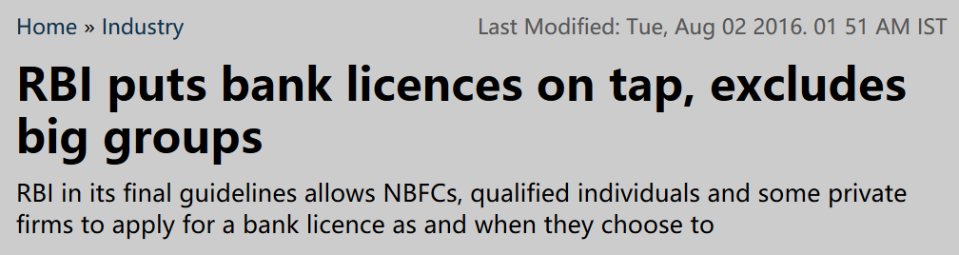
“On tap license” for private Commercial Banks
Till now: “Start & Stop”
UCB/PVB round#3: last date to apply was July 1, 2013…Bandhan, IDFC won license.
“On tap”
No “deadline for application”
Just like driving license, come when you’re ready
No need to wait for notification.

Slide 9
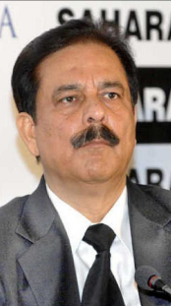
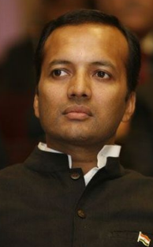

On tap license: min. paid up capital in Rs.crores
Share Capital = Liability for company
Round1 (ICICI)
100
Round 2 (Kotak)
200
Round 3 (Bandhan)
500
500
On Tap
Total assets: Rs.5k cr or LESS*
= large conglomerates & industrial houses…x
but allowed to invest upto 10%

Slide 10
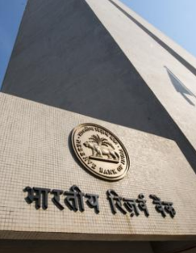
Universal commercial banks (Private) RBI guidelines 2016
On tap license
NBFC, individual, private companies with 10 years record.
Controlled by Indian. Ring-fencing from other ops.
25% branches in unbanked rural area, CRR, SLR, PSL, …. Same
Apply to Standing External Advisory Committee (SEAC) of RBI.
Round#3: ~25- two had won. Remaining [and others] can apply “on tap”. Although 2-3 max may win.
Future Foreign shareholding…max 74%
Notes:
promoters need not own more than a 51% stake in the NOFHC, compared with the 100% ownership mandated in the draft rules.
Is how if they are “owned and controlled by residents”. If such an entity has total assets of Rs.5,000 crore or more, the non-financial business should not account for 40% or more in terms of total assets or gross income.
https://www.rbi.org.in/Scripts/BS_PressReleaseDisplay.aspx?prid=37658
https://www.rbi.org.in/scripts/bs_viewcontent.aspx?Id=3220

Slide 11
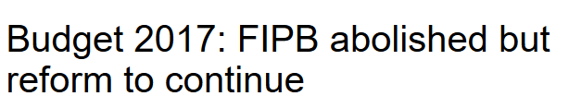
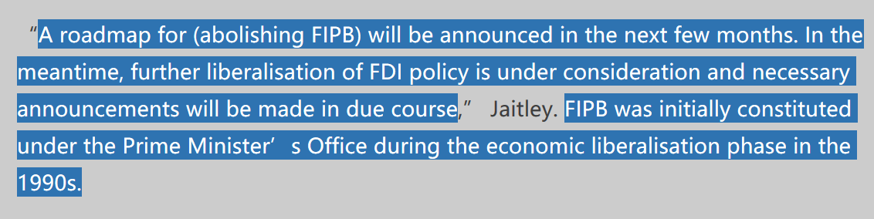
Foreign investment limits in Indian Commercial banks
India private Banks
74% (FIPB)
49% (automatic)
India Public sector Banks
20%
More on this in BES17 ”3”

Slide 13
Tainted History in Post Independent India
Foreign Banks
Nehruvian Socialist Economy: Disdain for PVB, Foreign Banks, esp. American banks, “coca cola capitalism”
80s: Bank of Credit and Commerce International (BCCI) by a Pak. Businessman
BCCI incorporated in Luxembourg (Tax haven)
1991: BCCI collapsed, $20 billion scam, England
1991: M.Narsimhan- allow more foreign banks. [IMF arm-twist??]

Slide 14
43 Foreign Commercial Banks (Foreign) IBA
AB Bank Limited
Abu Dhabi Commercial Bank Ltd.
American Express Banking Corpo
ANZ Banking Group Ltd.
Bank of America N.A.
Bank of Bahrain & Kuwait BSC
Barclays Bank Plc
BNP PARIBAS
Citibank N.A.
Commonwealth Bank of Australia
Cooperatieve Centrale Raiffeisen- Boerenleenbank B.A
Credit Agricole Corporate And Investment Bank
Credit Suisse AG
DBS Bank
Deutsche Bank AG
Doha Bank
FirstRand Bank
Industrial and Commercial Bank of China Ltd. (ICBC)
Industrial Bank Of Korea
J P Morgan Chase Bank, Nationa
JSC VTB Bank
KBC Bank N.V.
KEB Hana Bank
Krung Thai Bank Public Company
Mashreqbank psc
Mizuho Bank Ltd.
National Australia Bank (NAB)
National Bank of Abu Dhabi PJSC
PT Bank Maybank Indonesia TbK
Sberbank
SBM Bank (Mauritius) Ltd.
Shinhan Bank
Societe Generale
Sonali Bank Ltd.
Standard Chartered Bank
Sumitomo Mitsui Banking Corporation
The Bank of Nova Scotia
The Bank of Tokyo Mitsubishi UFJ Limited
The Hongkong & Shanghai Banking Corporation Ltd.
The Royal Bank of Scotland N V
United Overseas Bank Limited
Westpac Banking Corporation
Woori Bank
Incorporated abroad…opened branch / subsidiaries in India
But Post-2010 walla must convert branches to “Subsidiaries”- for stamp duty, capital gain tax, regulation.

Slide 15
“Universal“
Commercial Banks

Slide 16
Both are “commercial Banks” (running for profit) BUT
Type
Universal
Differential
Accept
Time & Demand Deposits of any amt
* Payment Bank 1 lakh
Give Loans to
Anyone [After 40% PSL]
*Payment Bank can’t; SFB, RRB: 75% to PSL
Open branches
Anywhere [After 25% Rural Mandate]
*LAB, RRB: Geographical Restrictions
Geographical expansion, deposit & lending ops. are restricted

Slide 17

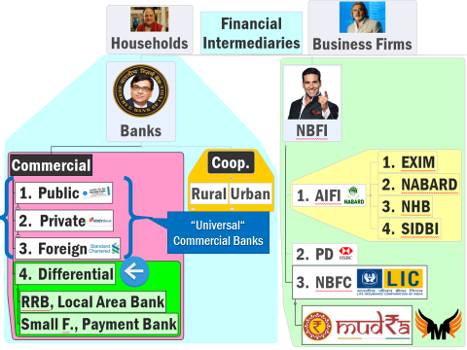
Commercial Banks →Differential Banks (Chronological order)
RRB [1976]
LAB [1996]
Small Finance Banks Payment Banks [2015]
Wholesale Bank (Proposed)

Slide 18
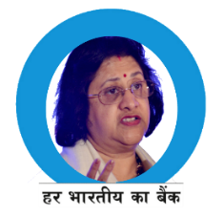
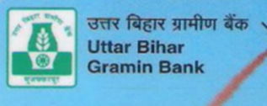
1976: RRB Act on Narsimhan Committee on Fin Inclusion
क्षेत्रीय ग्रामीण बेंक
वित्तीय समोवेशन
Banking Reg. Act
CRR, SLR (lecture)
PSL (lecture Link)
Presence
Yes
Yes + RRB Act ‘ 76
Yes
Yes
Yes (40%)
(75%) can’t lend >@avg coop
All India, Abroad
Few Districts
Type
Commercial (PSB,PVB,FB)
RRB
Vote power
Shareholding
U50|S15|SB35
MSF (lecture link)
Yes
No
RRB
Notes:
http://www.thehindubusinessline.com/money-and-banking/rbi-ups-rrbs-priority-sector-lending-target/article7948406.ece
https://www.rbi.org.in/Scripts/NotificationUser.aspx?Id=10155&Mode=0
RRBs not eligible for MSF https://www.rbi.org.in/scripts/NotificationUser.aspx?Id=6394&Mode=0
Only SCB.

Slide 19
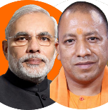




RRB Act ‘76-> amendment act 2015
Lend money, train staff.
Encourages mergers among RRBs
Term and tenure limit for board of directors, More here.
Total authorized capital 5 crore
Authorized 2000 Cr.
Notes:
RRB can appoint Board of directors from outside union-state and sponsor bank nominated people.One person cannot become director in 2 RRBs.3 yearsPerson cannot remain director for more than 6 years. (Meaning one individual can be an RRB director for only two terms 3 + 3.)

Slide 20
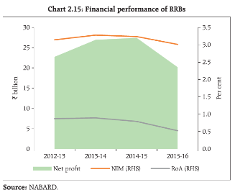
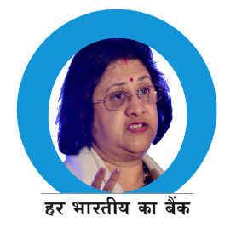




45 out total 56 RRBs are sustainable.
Urbanization
Savings, FD इधर
Loan इधर &
Expect debt waiver
Can’t lend higher than prevailing coop rates
Loan and Money laundering
Funding from here, since deposits low

Slide 21
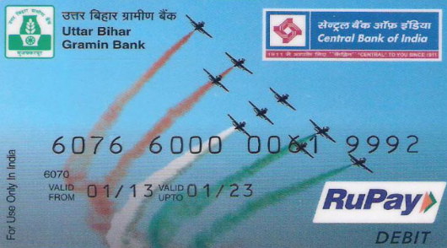
This is its Sponsor bank. Lend money, train staff
This is an RRB
Payment Gateway

Slide 22
Commercial Banks →Differential Banks (Chronological order)
RRB [1976]
LAB [1996]
Small Finance Banks Payment Banks [2015]
Wholesale Bank (Proposed)

Slide 23
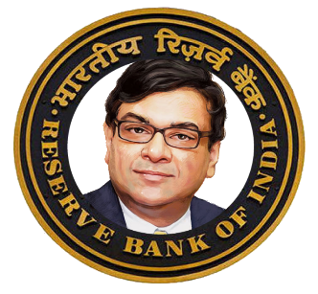
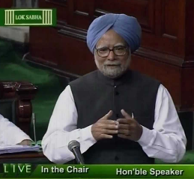
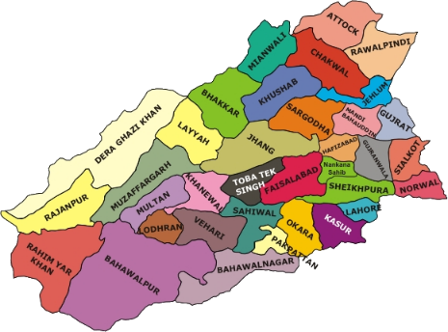

FI ►Bank ► Commercial Bank ► Diff. Bank ► Local Area Bank
Licensed under Banking Regulation Act 1949. [SLR]
But not in 2nd Schedule of RBI Act 1934- so all norms with caveats [CRR etc.]
Budget 1996
Scheduled Bank
Min.Paid up Capital Rs.5 lakh
Protect interest of depositors
RBI Act 1934 Sch.2
Only rural and semi-urban areas
Max. 3 geographically contiguous districts.
only 1 urban centre/District

Slide 24
If a bank is not a scheduled bank…
All foreign banks not having branch in India; Some UCB, and all LAB.
No PSL obligations … ☺ [But LAB required.]
State/Central PSUs/institutes don't open account
Branch expansion heavily restricted, need RBI approval.
Micro-Small enterprises loans not covered under Credit guarantee scheme of Govt.
Farms loans not covered under Interest subvention scheme (ISS only for PSB, RRB).
Can't get loans from RBI @Bank rate /MSF
Can't get refinance from NABAD/SIDBI

Slide 25


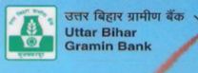
Let’s compare: LAB not scheduled, so norms with caveats
Para
CRR
Universal
Differential-RRB
Differential-LAB
SLR
PSL
Yes
Yes
40%
Yes
Yes
75%
Yes-RRB
Yes-RRB
40%
Branch
3 district
everywhere
Few district

Slide 26
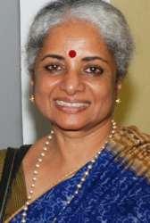

Originally 10-> 4 -> 3 after “EXIT” of Capital LAB
Coastal Bank Andhra Pradesh (first '99)
Subhadhra Local Area Bank, Kolhapur
Krishna Bhima Samruddhi (Andhra & Karnataka)
Capital Local Area Bank: Punjab (Largest)
4 LAB
2015: allowed to apply for Small F. Bank license
Usha Thorat Committee
Later can become Universal commercial bank
Converted to SFB
1st SFB to start ops
(April 2016)

Slide 27
Commercial Banks →Differential Banks (Chronological order)
RRB [1976]
LAB [1996]
Small Finance Banks Payment Banks [2015]
Wholesale Bank (Proposed)

Slide 28
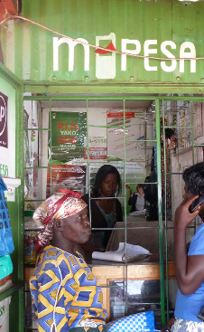
Payment Bank Why?
Inspired from Vodafone m-pesa (Kenya)
Mobile recharge, kiranawala…banking, remittance, even crop insurance!
Airtel money, oxycash etc.-> “prepaid payment instruments”:
Cost of remitting 5k: Post office (250), Branch (150- wageloss), PPI (0-75*)
better convert PPIs to “Banks” for more fin. Inclusion, regulation.

Slide 29


Small Finance Banks, Why
Inspired from Community banks of USA. Locally owned and operated- help farmers, ranchers, MSE. Better “intelligence”-> lower NPA.
Indian parallels:
i) Pvt: non-nationalized PVB (Catholic Syrian Bank, Nanital Bank, RBL Ratnagiri; & LAB
(ii) Public: RRB, Cooperative Banks; but total size very low

Slide 30
Commercial Banks-> differential Banks-> SFB,PyB
RBI’s Nachiket Mor Committee recommends both (2014)
Bhai accepted, invited applications (2014, Nov)
Usha Thorat Committee: Small F. Banks- 10 winners
Nachiket Mor Committee: Payment Banks- 11 winners

Slide 31

Different Norms: Eligibility?
10 small finance banks
11 payments banks
Existing PPI (pre-paid payment instrument)
Individual with 10 year xp in banking/finance
individuals / professionals; Non-Banking Finance Companies (NBFCs), corporate BCs, mobile telephone companies, super-market chains, companies, real sector cooperatives; that are owned and controlled by residents; and public sector entities
Existing NBFC, Microfinance,LAB
Preference to NE, Central India clusters
Notes:
A’bad / TN = SSI edge in PSL
No credit card= no KCC

Slide 32


Different Norms: Who won?
Small F. Banks (10/72)
Au Financiers (Jaipur)
Equitas Holdings (Chennai)
ESAF Microfin (Chennai)
Janalakshmi Financial Services (Bengaluru)
RGVN (Northeast) Microfin (Guwahati)
Suryoday Microfin (Navi Mumbai)
Ujjivan Financial Services (Bengaluru)
Utkarsh Microfin (Varanasi)
Payment Banks (3-11/41)
Department of Posts
Fino PayTech Ltd (backed by IFC-W.Bank)
Reliance Industries Ltd (Mukesh+SBI)
Vijay Shekhar Sharma (Paytm)
Vodafone m-pesa (tied with ICICI)
Aditya Birla Nuvo Ltd (with IDEA)
Tech Mahindra Ltd
Cholamandalam Distri. Services Ltd
Capital Local Area Bank (Jalandhar)
Disha Microfin (Ahmedabad)
Dilip Shantilal Shanghvi (Sun Pharma + Telenor)
Airtel M Commerce Services Ltd (with Kotak Mahindra Bank)
National Securities Depository Ltd
RBI Board Dir. Nachiket Mor
Ex-Dy Gov. Usha Thorat
Notes:
A’bad / TN = SSI edge in PSL
No credit card= no KCC
http://www.financialexpress.com/article/industry/banking-finance/rbi-grants-approval-to-10-entities-for-small-banks-all-you-need-to-know/137194/
The prominent names among 30 applicants which lost out in the race a licence include NSE Strategic Investment Corporation Limited promoted by the National Stock Exchange, MG George Muthoot, Videocon d2h and Kishore L Biyani. Payment solutions companies, including Itz Cash Card, Citrus Payment, Smart Payment Solutions, One Mobikwik and Oxigen Services did not make up the grade.

Slide 33

SFB PyB
Common features
Like private universal commercial banks
CRR, SLR applicable*
FDI: 49% automatic, upto 74% with approval
Can access repo market
Can open branch, appoint Business Correspondent (BC), ATM.
Can give ATM/ Debit cards..YES
Can Sell MF, Pension, Insurance, foreign currency, but can't use its own funds [deposits]

Slide 34
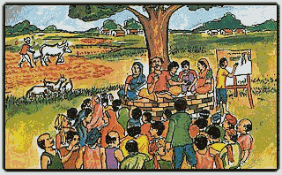
Different Norms: Rural Penetration
10 small finance banks
25% branches in unbanked rural area with upto 9,999 pop. Under Census-2011
(11-3) payments banks
No need, but 25% of access points must be with rural-BC
Can be BC of another bank.
Mobile Recharge network far bigger than branches.
Notes:
http://censusindia.gov.in/2011-prov-results/paper2/data_files/India2/1.%20Data%20Highlight.pdf

Slide 35


Different Norms: Client Base?
10 small finance banks
8 payments banks
Promoting Small savings
Unserved
Underserved
Farmers-small, marginal
Micro, Small industries
Remittance to migrant labour families, low income households, unorg. Sector, small business
Notes:
A’bad / TN = SSI edge in PSL
No credit card= no KCC

Slide 36
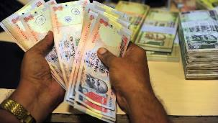
Different Norms: Deposits
CRITICISM: PSB have enrolled most in Jandhan-DBT then who’ll come?
CRITICISM: Kerala, HAWALA
10 small finance banks
(11-3) payments banks
No such limits
Time & Demand…yes
Max. balance Rs.1 lakh per year per customer
No NRI deposits
NO CREDIT CARD.
YES ATM/DEBIT
Notes:
A’bad / TN = SSI edge in PSL
No credit card= no KCC
Demand Deposit: Small Savings Account
Aggregate Rs.1 lakh per year
Withdraw max. 10k per month
Max. Balance @Anytime 50k

Slide 37


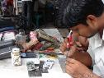
Loan biz: PSL (MORE DETAILs in this lecture link)
Category | % SCB loans
Weaker Sections | 10%
Agri | 10%
*Marginal Farmer (upto 1ht) *Small farmer (>1 upto 2ht) | 8%
Micro Enterprises Khadi-Village indu. | 7.50%
All PSL categories | 4.5%
Total PSL | 40%
Disha Microfin (SFB)
A’bad GIDC network “edge”= rest 35%
RRB & SFB:75%
Notes:
After reviewing in 2017 they’ll do post-2018
Total Priority Sector Target within a maximum period of five years starting from April 1, 2013 and ending on March 31, 2018 as per the action plans submitted by them and approved by RBI.

Slide 38
Different Norms: Loan Business
NABARD, SIDBI, Mudra-> PSB/PSL; RRB,cooperatives
+ ..Duplication, shell firms: NPA
Then how you can call it a “bank”? And how will it sustain?
10 small finance banks
(11-3) payments banks
Can’t loan, So no PSL
40% strictly categorywise as SCB-PSL
35% into PSL with competitive edge.
=Total 75% PSL
50% of loan portfolio upto 25 Lakhs’ loans
Can’t issue credit card
Min.75% of Demand deposits in Gsec,T-Bill
Max.25% of all deposits in other SCB
Justification: creative products, bancassurance, MF..
Then lower commission @SCB by competition, innovative products like seed insurance
Justification: Difficult to revamp RRB, Cooperative, LAB.
Notes:
A’bad / TN = SSI edge in PSL
No credit card= no KCC

Slide 39

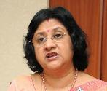
Different Norms: Future growth & evolution
10 small finance banks
Can evolve into Universal Bank after 5 years, on RBI discretion
(11-3) payments banks
Not explicitly mentioned
Competition among business firms =better services for clients.
SCBs already troubled…now more competition? ☹ entry of corporates = dog eat dog scenario. 3 already dropped!
Notes:
Dilip Shantilal Shanghvi (Sun Pharma- Telenor-IDFC)
Tech Mahindra Ltd
Cholamandalam Distri. Services Ltd
Payment bank can’t lend money, issue credit card so where is the margin to sustain!!?
Viz a viz dept of post got payment bank license, Airtel, PayTM base is huge …then how to penetrate?

Slide 40

Why Small f. & Payment banks
Justification
If PSBs, cooperative banks, RRB panacea for financial inclusion then Why Shardha chit fund scam and Rose Valley Chit fund scam?
Even Surevy-2015-16 suggested more number and variety of banks. (4R4D Lecture Link)
Better competition, more inclusion, tapping PPI- mobile reach
AND there are sufficient safeguards

Slide 41
Small f. & Payment banks
safeguards
Must be a public ltd. Company with Min. 100 cr. Capital
1934: Must be scheduled bank under RBI Act [CRR]
1949: Banking regulation act [SLR]
1961: DICGC Act deposits “insured”
2006: Banking Ombudsman will have jurisdiction
2007: Payment and Settlement Systems Act, 2007 [RBI regulations]
2013: Companies Act Majority of directors must be “independent”.
BASEL-III: capital to risk weight asset ratio (CRAR) is tighter. (SCB: 9%, for these two: 15%. More in this lecture link).

Slide 42

On tap license
Till now
UCB/PVB round#3: last date to apply was July 1, 2013…Bandhan, IDFC won license.
On tap
No “deadline for application”
Just like driving license, come when you’re ready
No need to wait for notification.
SFB/PB Round#1: last date to apply was Jan 1, 2015.
UCB/PVB…yes guidelines
SFB/PB:…?? (waiting- should consider raising entry capital, penalty for leaving).

Slide 43
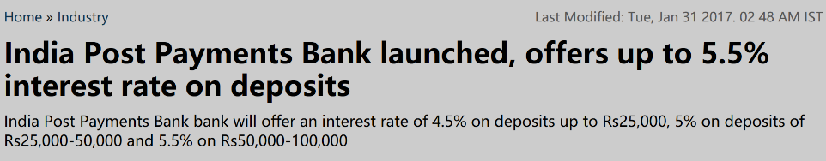
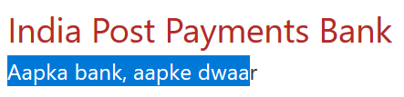
Launched January 2017: 1st PB: Airtel, 2nd IPPB (HQ Delhi)
Govt:
125 Cr. as Capital
375 cr. As Grant
Doorstep banking*
USSD banking
Free ATM @PNB, IPPB
Free Debit card, commerce
Cheque book
DBT subsidies
More on this page
SAFAL
Sugam
Basic-small
Regular
SARAL
Basic
No KYC
2 free remittances per month
Initial Rs.100, then no minimum balance requirement
Age: 10 years / >
Notes:
Quarterly interest payment

Slide 44
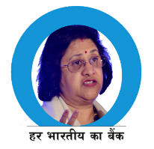

Let’s Compare for MCQs
para
CRR, SLR
Deposit
SBI
yes
As much as client can give
Airtel
IPPB
CRR Yes| SLR*
same
1 lakh
1 lakh
Interest
Loan
~4% Savings ~7% on FD
Anyone, PSL
~7.25%**
4.5% to 5.5%* balance
Can’t
Can’t
Payment Banks
Paytm Payment Bank to start ops by May 2017.
Chronology: 1) Airtel 2) Post 3) Paytm
Notes:
but charges on withdrawal (~FD)

Slide 45

Commercial Banks →Differential Banks (Chronological order)
RRB [1976]
LAB [1996]
Small Finance Banks Payment Banks [2015]
Wholesale Bank (Proposed)
NEXT LECTURE

